Slide 1

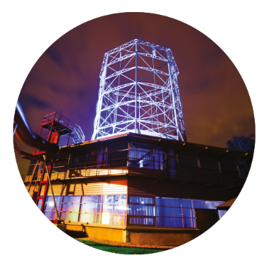




Veranstaltungsname 2021
Oktogon | Zeche Zollverein
Agenda
morning
afternoon
Warm up
- Memories from last night -
9:00
9:15
Break-out-Session 1
Fully automated Production Supply: Integration of Logistics use cases at the Digital Factory
-Public Cloud – Making the next move to a Cloud First Strategy
-DevOps for S4
-Blockchain in the Finance World – How a myth turns to reality
-Digital Supply Chain Dashboard – Increase your supply chain transparency
Welcome
9:15
9:20
Melanie Mittmann
Max Mustermann
Service Line
- Let‘s move on -
9:30
9:50
Stephan Stups
13:15
13:45
The Yin and Yang of
Business Transformation
9:50
10:05
Marta Muster
CEO Muster AG
Transformation in a
Large corporate
10:05
10:15
Edgar Eins
Prof. University
Break
13:45
13:55
Break
10:15
10:30
Edgar Eins
Prof. University
Break-out Session 2
13:55
14:25
Transformation Tour –
Design Museum /
Ruhrmuseum
Coffee Break
14:25
14:55
Fun Event
10:30
12:15
Break-out Session 2
14:55
15:20
Lunch
12:15
13:15
Break
15:20
15:30
End of Plenum
16:00
Bus transfer
16:15

Slide 2
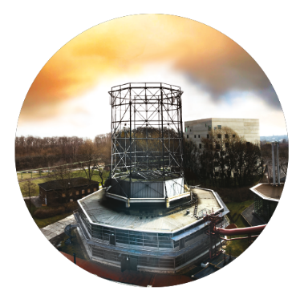
Veranstaltungsname 2021
Oktogon | Zeche Zollverein
Agenda
24. Dezember 2021
Warm up
- Memories from last night -
9:00
9:15
Welcome
9:15
9:20
Melanie Mittmann
Max Mustermann
Service Line
- Let‘s move on -
9:30
9:50
Stephan Stups
The Yin and Yang of
Business Transformation
9:50
10:05
Marta Muster
CEO Muster AG
Transformation in a
Large corporate
10:05
10:15
Edgar Eins
Prof. University
Break
10:15
10:30
Edgar Eins
Prof. University
Transformation Tour –
Design Museum /
Ruhrmuseum
Fun Event
10:30
12:15
Lunch
12:15
13:15
Our EMEA SAP Ambition, Strategy and Plan
13:15
15:40
Liz Lorem
End of Plenum
16:00
Bus transfer
16:15

